Slide 1
Chapter 10: Management, Leadership, and Ethics
-- Dr. L. Daniel Otero, Florida Institute of Technology --
Session I: Design Management Framework

Slide 2
Session’s Agenda
Software Design Management
  What is software design management?
  Why study software design management?
A Design Management Framework
  Quality in software design
  Typical project lifecycle
  Typical performance measures in project phases
  Components of the design management framework
What’s next…

Slide 3
Software Design Management
What is software design management?
  Software design is the process of transforming functional and non-functional requirements into models that describe a technical solution.
    Can be viewed as a complex decision problem since
      there are many ways to design a software system, and
      software engineers must make design decisions to achieve the required goals of the software system in the most effective manner
  Management is a set of activities directed at an organization's resources to achieve organizational goals in an efficient and effective manner.
    Activities: planning and decision making, organizing, leading, and controlling
    Resources: human, financial, physical, and information
  In the design phase, management refers to activities required to efficiently create quality design artifacts, within schedule and budget constraints.
Notes:
Software Design + Management Practices = Software Design Management

Slide 4
Software Design Management
Why study software design management?
  In large-scale software projects, software design management is essential to plan, organize, staff, track, and lead the activities required to carry out successfully the software architecture and detailed design steps.
  To understand relevant managerial techniques and concepts
    This will help to effectively use resources to achieve the various goals for each main component in the design phase (i.e., software architecture, detailed design, and documentation).
    Effective use of resources is key to the success of software design management.
  In the general sense, software design management is needed to:
    Control/monitor design processes
    Manage the resources necessary for completing quality design artifacts according to organizational goals

Slide 5

The Concept of Quality
Quality is a performance measure for a service provided or a product produced
Quality is relative to a particular stakeholder. For example:
  A personal website can be classified as high-quality by the programmer that developed it, and as low quality by user clients. Why?
    Because both stakeholders have different parameters by which they measure quality
      The programmer may perceive quality in terms of being able to use appropriate colors and organize the website to run on a particular web browser.
      A client using a different web browser may not see the website’s organization and colors as intended; thus perceiving the website’s quality as poor.
Although the quality of a software design can be assessed in various ways, from a management's perspective, quality of software design tends to be evaluated in terms of cost and scheduling.
  Thus, it is important to understand project management techniques that can be used to keep design artifacts within cost and schedule thresholds.
Notes:
Two stakeholders of the software system have different opinions regarding the quality of the product produced.

Slide 6
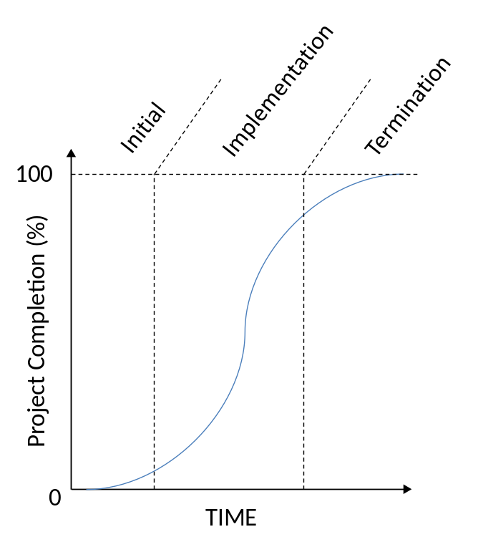
Design Management Framework
It is beneficial to view the design phase as a project. Why?
  Project management techniques can be directly applied to the design phase
    This will help to efficiently and effectively manage the software design activities
    E.g., the life cycle of the design phase can be represented with three stages as in:
This life cycle represents a typical project pattern
  Contributions to a project’s completion are:
    Relatively small during the initial and termination phases
    Significantly high during the implementation phase
When defining a life cycle structure for a project, we can decompose a project into its appropriate stages, and manage each stage individually.

Slide 7
Lifecycle Stages
In the initial stage, there are two main objectives:
  Achieve a clear understanding of the tasks to be accomplished and the resources that are necessary to successfully complete the tasks.
  Develop a plan to complete the project’s tasks within schedule and budget constraints.
The initial phase is characterized by planning activities.
  Although some of the artifacts resulting from this phase (e.g., schedule) may be deliverables to clients, this phase is not viewed as contributing significantly to the percentage project completion.
The implementation stage is where:
  Most of the effort is employed
  Most of the design project deliverables are achieved, including completed design documents
  The percent project completion is the highest

Slide 8
Objectives in the Lifecycle Stages
In the termination stage,
  Key activities involve verification that everything is in place for a smooth transition into the code construction phase. Examples of activities are:
    Making sure that the latest versions of the design documents are securely stored according to configuration management procedures
    Updating schedule and cost current values
    Re-evaluating schedule and budget plans based on the resulting performance measures of the design phase
    Communicating results to upper management.
The design documents generated in this stage are critical for the robustness and maintainability of the software designed.
  However, the relative impact of this stage to project completion is not viewed as significant as that of the implementation phase.

Slide 9

Managing Lifecycle Stages
The lifecycle stages of a design project must be individually managed to ensure acceptable levels of quality and performance measures.
  What does this means?
    For example, an important outcome of the planning stage is a clear understanding of the tasks to be accomplished and the resources that are necessary to successfully complete the tasks.
      Various project management techniques exist to help achieve this outcome.
It is important to know how to apply appropriate project management techniques to each of the design project stages
  Afterwards, peer reviews will help ensure that the objectives of the planning stage are achieved.
    Peer reviews must be conducted throughout these stages to
    minimize the propagation of errors to subsequent stages and
    apply corrective actions.

Slide 10
Design Management Framework
Each of the design project lifecycle stages are associated with different performance measures. For example:
  In the planning stage, performance measures such as the following are relevant:
    Thoroughness (everything is considered),
    Completeness (complete definition of plans),
    Accuracy of estimates.
  In the execution/implementation stage,
    Quality is a function of a series of technical attributes of software designs.
    Managing during this stage is mainly a monitoring approach to make sure that the plan is been followed, and take corrective actions if necessary.
Leadership and good ethical conduct are important factors that affect the effectiveness of managing each lifecycle stage.

Slide 11
Design Management Framework
Thus, an appropriate design management framework is one that considers the following 4 areas:
Design Management Framework
Execution/
Implementation
Termination
Planning
Leadership &
Ethics

Slide 12
What’s Next…
This session accomplished the following:
  Defined software design management
  Understood the importance of studying software design management
  Discussed the concept of quality in software design management
  Described the stages of a typical project lifecycle
  Described typical performance measures in project phases
  Defined a design management framework composed of four components:
    Planning
    Implementation/Execution
    Termination
    Leadership & Ethics
Next session will focus on the planning component of the design management framework,
  This session will focus on managerial concepts and techniques that are relevant to the planning phase.

Slide 13

Questions?

